Slide 1

Data Analytics Track – Virtual HealthCare
Team – Dummy Variables

Slide 2

Agenda
E-healthcare boom in New Brunswick
Traits of Patients and Physicians that embraced e-care
Future of e-healthcare in New Brunswick

Slide 3
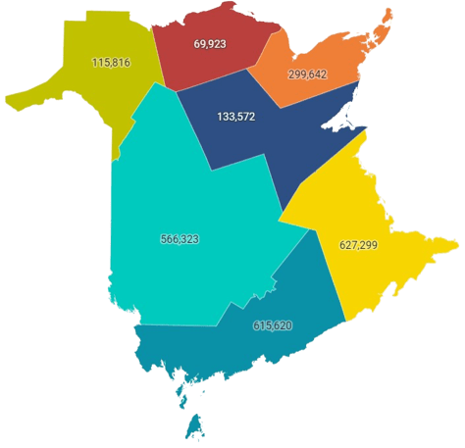



A Synopsis of New Brunswick Patient’s
Health Zones
Average Annual Visits in Health Zones
Total No. of Visits
2.4M
Male Patients
43%
Female Patients
57%
Zone 1 (Moncton Area)
Zone 2 (Saint John Area)
Zone 3 (Fredericton Area)
Zone 4 (Edmundston Area)
Zone 5 (Campbellton Area)
Zone 6 (Bathurst Area)
Zone 7 (Miramichi Area)

Slide 4

Covid gave life to a new healthcare delivery mode
Boom of Virtual Healthcare system in New Brunswick
>133k
Pre Covid
During Covid
average month virtual visits by patients across health zones in 2020
>135k
average month virtual visits by patients across health zones in 2021

Slide 5

Patients that embraced the e-healthcare
Health Zones
70%
Virtual visits were in Moncton
Saint John and Fredericton
~1 in 3
visits were virtual in
Saint John and Fredericton
~1 in 2
visits were virtual in
Other Areas
Bathurst & Miramichi have more VC visits than in-person

Slide 6

Patients that embraced the e-healthcare
Gender across Health Zones
>300k
virtual visits were Females patients across each Fredericton, Moncton & Saint John Area
~55-60%
of the virtual visits across each heath zone were made by Females patients

Slide 7


Patients that embraced the e-healthcare
Age Group across Health Zones
>1800k
virtual visits were made by patients 40 -79 years old
~10-30%
of the patients below 20 years preferred virtual visits
~40-45%
of the patients across all age groups above 20 years preferred virtual visits

Slide 8

Physicians that provided e-healthcare facilities
Health Zones
70%
Virtual visits were in Moncton
Saint John and Fredricton
~1 in 3
visits were virtual in
Saint John and Fredricton
~1 in 2
visits were virtual in other areas

Slide 9

Physicians that provided e-healthcare facilities
Gender across Health Zones
738k
Times patients consulted virtually to Females physicians across each Bathurst, Moncton & Edmunston Area
~40%
of the virtual visits were made to male physicians across other areas

Slide 10
Future of E-Healthcare in New Brunswick
Hybrid Model

Slide 11
Questions

Slide 13
Model Name | Root Mean Square (RMS)
ARIMA | 2184834075.04
Additive Holt’s Winter Seasonal Exponential Smoothing | 2333228140.1894107
Multiplicative Holt’s Winter Seasonal Exponential Smoothing | 2346924815.6976314

Slide 14
Future of E-Healthcare in New Brunswick
There is boom but slow growth. Check month on month

Slide 15
Traits - Physicians used e-healthcare delivery mode

Slide 16
New Brunswick has the 2nd highest Wait Time after Nova Scotia

Slide 17
Why NB need to make a shift to e-HealthCare
https://agewell-nih-appta.ca/wp-content/uploads/2021/01/ENG-The-Benefits-and-Challenges-of-Virtual-Geriatric-Care-in-New-Brunswick.pdf
Citizens who experienced transportation problems in getting the health care they needed in the last 12 months
https://nbhc.ca/indicators/ph_bartp_1
Citizens who experienced difficulties in getting the health care they needed in the last 12 months because they were unable to leave the house due to a health problem
https://nbhc.ca/indicators/ph_barlh_1
When we invest in health, We finance the future
Do people trust Telemedice

Slide 18
Do People Trust e-Health? Hybrid Model is the way to go forward
Geography or group | 2020 | 2017 | 2014 | 2011
New Brunswick | 11.1715 | 9.62066 | 12.4467 | 16.8528
Without disability | 4.65211 | 4.00575 | 5.80886 | n/a
With disability | 30.3143 | 28.5794 | 35.5516 | n/a

Slide 19
Do People Trust e-Health?

Slide 21
Do People Trust e-Health?

